Slide 1
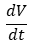
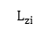
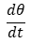
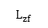
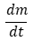
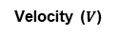
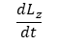
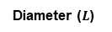
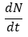
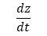
Projectile Characteristics
Density (ρ)
Diameter ($L$)
Velocity ($V$)
Angle (θ)
M
Iron
1 m
1 km/s
90 ̊
P
Stony-Iron
45 ̊
S
Stony
15 ̊
C
Chondritic
10 km
40 km/s
Atmospheric Effects
Atmospheric Conditions
$$\frac{dz}{dt}$$
Disintegration
Top of Atmosphere
Gravity
$$\frac{dL_{z}}{dt}$$
Dispersion
z_{b}
g _{T}
Altitude
Atmospheric
Profiles
$$\frac{dN}{dt}$$
Fragmentation
$$L_{zi}$$
Airburst
Surface
z
Pressure
N_{i}
z*
$$L_{zf}$$
D_{SC}
P(z)
Temperature
Ablation
N_{f}
Simple-to-Complex
Crater Diameter
T(z)
$$\frac{dm}{dt}$$
m_{i}
P₀
ρ_{a} (z)
Density
m_{f}
Simple
T₀
$$\frac{dθ}{dt}$$
Angle
Impact
Characteristics
Target
Characteristics
ρ₀
θ_{i}
Scale
Height
θ_{f}
Complex
H_{T}
$$\frac{dV}{dt}$$
Velocity
Crater
Formation
R_{T}
Surface
Density
ρ_{T}
V_{i}
V_{f}
Target
Radius
* Not to scale
Notes:
AEM diagram. A representation of all factors taken into account within AEM, including (A) characteristics of each projectile in the population, (B) atmospheric effects and impact characteristics, and (C) atmospheric conditions and target characteristics. See Section~\ref{sec:methodover} for reference.​

Slide 2
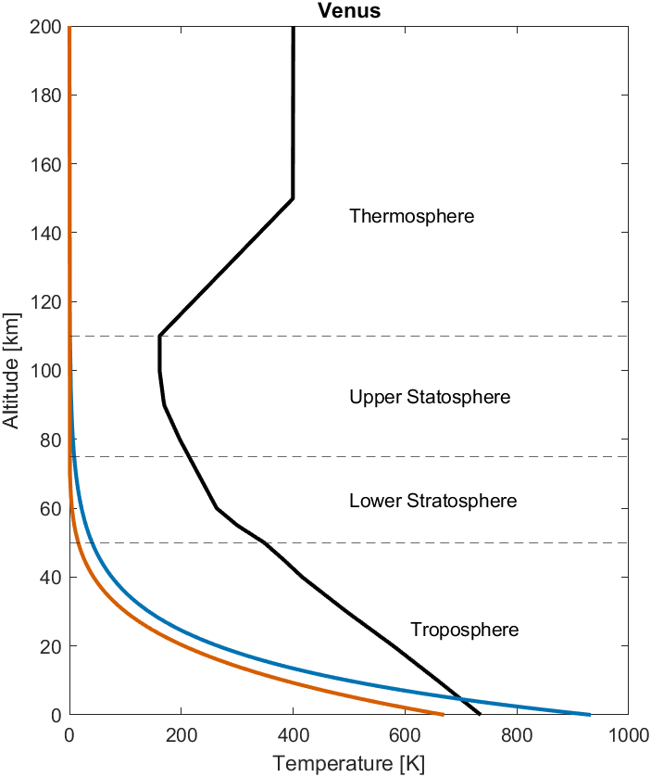
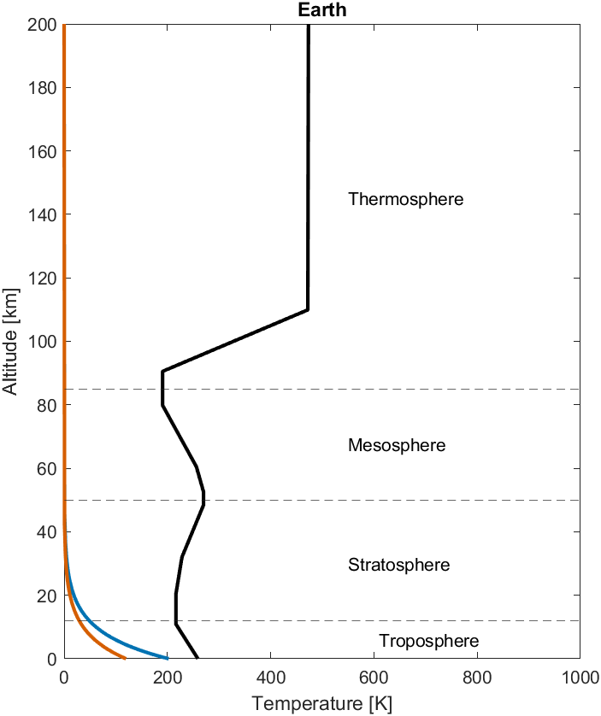
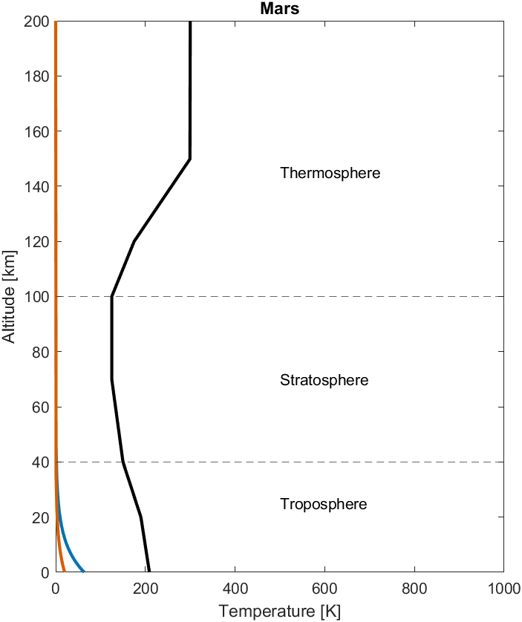
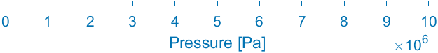
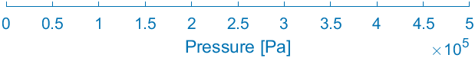
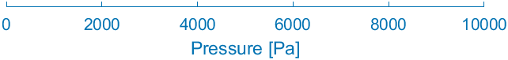
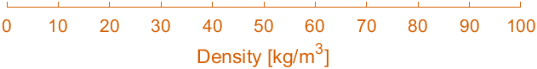
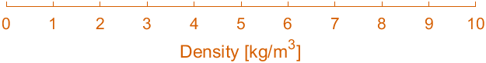
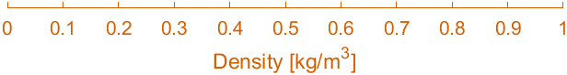
Planetary Atmospheric Conditions
Notes:
%% Theoretical Venusian Crater Size-Frequency Distribution
% Atmospheric effects code
% Developed by: Marissa Dudek (1), R Shane McGary (2)
% (1) University of North Carolina at Chapel Hill, Geological Sciences
% (2) James Madison University, Geology and Environmental Sciences
% Clean workspace
clc; format long;
counter = 0;
% ----------------------------------------------------------------------------
% Import previously created workspace
% ... Read as 'SectionsOfCodeRun_Date_Target_NumberProjectiles'
load('CSFD_211005_ProjectilePop_unique\All_Variables.mat')
% Establish zeros matricies
proj_alt = (1:1:200000).';
proj_ztemp = zeros(200000,1);
proj_zrho = zeros(200000,1);
proj_zpress = zeros(200000,1);
flag.zrho(1) = 2;
% ----------------------------------------------------------------------------
% Venus
for j = 1:200000
% ---------------------------
% Blumenthal, Kay, Palen, Smith (2012). Understanding Our Universe. New York: W.W. Norton & Company. p. 167. ISBN 9780393912104.
% ... temperature (C)
if proj_alt(j) >= 150000
proj_ztemp(j) = 127;
elseif proj_alt(j) >= 110000
proj_ztemp(j) = ((proj_alt(j)-150000)/((150000-110000)/((127)-(-112))))+(127);
elseif proj_alt(j) >= 100000
proj_ztemp(j) = -112;
elseif proj_alt(j) >= 90000
proj_ztemp(j) = ((proj_alt(j)-100000)/((100000-90000)/((-112)-(-104))))+(-112);
elseif proj_alt(j) >= 80000
proj_ztemp(j) = ((proj_alt(j)-90000)/((90000-80000)/((-104)-(-76))))+(-104);
elseif proj_alt(j) >= 70000
proj_ztemp(j) = ((proj_alt(j)-80000)/((80000-70000)/((-76)-(-43))))+(-76);
elseif proj_alt(j) >= 60000
proj_ztemp(j) = ((proj_alt(j)-70000)/((70000-60000)/((-43)-(-10))))+(-43);
elseif proj_alt(j) >= 55000
proj_ztemp(j) = ((proj_alt(j)-60000)/((60000-55000)/((-10)-(27))))+(-10);
elseif proj_alt(j) >= 50000
proj_ztemp(j) = ((proj_alt(j)-55000)/((55000-50000)/((27)-(75))))+(27);
elseif proj_alt(j) >= 45000
proj_ztemp(j) = ((proj_alt(j)-50000)/((50000-45000)/((75)-(110))))+(75);
elseif proj_alt(j) >= 40000
proj_ztemp(j) = ((proj_alt(j)-45000)/((45000-40000)/((110)-(143))))+(110);
elseif proj_alt(j) >= 30000
proj_ztemp(j) = ((proj_alt(j)-40000)/((40000-30000)/((143)-(222))))+(143);
elseif proj_alt(j) >= 20000
proj_ztemp(j) = ((proj_alt(j)-30000)/((30000-20000)/((222)-(306))))+(222);
elseif proj_alt(j) >= 10000
proj_ztemp(j) = ((proj_alt(j)-20000)/((20000-10000)/((306)-(385))))+(306);
elseif proj_alt(j) >= 0
proj_ztemp(j) = ((proj_alt(j)-10000)/((10000-0)/(385-(462))))+(385);
end
% ---------------------------
% ... convert temperature from celcius to kelvin (K)
proj_ztemp(j) = (proj_ztemp(j) + 273.15);
% ---------------------------
% ... density (kg/m3)
if flag.zrho(1) == 1
proj_zrho(j) = 67 * (exp(-proj_alt(j)/H.target));
else
% Herrick and Phillips (pg. 260-261)
if proj_alt(j) >= 70000
proj_zrho(j) = 0.0789 * (exp(-23.3*((proj_alt(j)-70000)/100000)));
%proj_zrho(j) = 67 * (exp(-proj_alt(j)/H.target));
elseif proj_alt(j) < 70000
proj_zrho(j) = 67 * ((1-(proj_alt(j)/94800))^5);
end
end
% ---------------------------
% ... pressure (Pa)
proj_zpress(j) = (93.22*(10^5)) * (exp((-g.Venus*0.04334*proj_alt(j))/(8.314*737)));
% ---------------------------
end
Vztemp = proj_ztemp;
Vzrho = proj_zrho;
Vzpress = proj_zpress;
% Earth
for j = 1:200000
% ---------------------------
% ... temperature (C)
if proj_alt(j) >= 110000
proj_ztemp(j) = 200;
elseif proj_alt(j) >= 90500
proj_ztemp(j) = ((proj_alt(j)-110000)/((110000-90500)/(200-(-83))))+(200);
elseif proj_alt(j) >= 80000
proj_ztemp(j) = -83;
elseif proj_alt(j) >= 60500
proj_ztemp(j) = ((proj_alt(j)-80000)/((80000-60500)/((-83)-(-17))))+(-83);
elseif proj_alt(j) >= 52500
proj_ztemp(j) = ((proj_alt(j)-60500)/((60500-52500)/((-17)-(-3))))+(-17);
elseif proj_alt(j) >= 48500
proj_ztemp(j) = -3;
elseif proj_alt(j) >= 32000
proj_ztemp(j) = ((proj_alt(j)-48500)/((48500-32000)/((-3)-(-45))))+(-3);
elseif proj_alt(j) >= 20000
proj_ztemp(j) = ((proj_alt(j)-32000)/((32000-20000)/((-45)-(-57))))+(-45);
elseif proj_alt(j) >= 11000
proj_ztemp(j) = -57;
elseif proj_alt(j) >= 0
proj_ztemp(j) = ((proj_alt(j)-11000)/((11000-0)/(14+(-57))))+(-57);
end
% ---------------------------
% ... convert temperature from celcius to kelvin
proj_ztemp(j) = (proj_ztemp(j) + 273.15);
% ---------------------------
% ... density (kg/m3)
proj_zrho(j) = (1.20) * (exp(-proj_alt(j)/H.Earth));
% ---------------------------
% ... pressure (Pa)
proj_zpress(j) = (10.13*(10^4)) * (exp((-g.Earth*0.02896*proj_alt(j))/(8.314*288)));
% ---------------------------
end
Eztemp = proj_ztemp;
Ezrho = proj_zrho;
Ezpress = proj_zpress;
% Mars
for j = 1:200000
% ---------------------------
% ... temperature (K)
if proj_alt(j) >= 150000
proj_ztemp(j) = 300;
elseif proj_alt(j) >= 120000
proj_ztemp(j) = ((proj_alt(j)-150000)/((150000-120000)/(300-(175))))+(300);
elseif proj_alt(j) >= 100000
proj_ztemp(j) = ((proj_alt(j)-120000)/((120000-100000)/(175-(125))))+(175);
elseif proj_alt(j) >= 70000
proj_ztemp(j) = ((proj_alt(j)-90000)/((90000-70000)/(125-(125))))+(125);
elseif proj_alt(j) >= 40000
proj_ztemp(j) = ((proj_alt(j)-70000)/((70000-40000)/(125-(150))))+(125);
elseif proj_alt(j) >= 30000
proj_ztemp(j) = ((proj_alt(j)-40000)/((40000-30000)/(150-(170))))+(150);
elseif proj_alt(j) >= 20000
proj_ztemp(j) = ((proj_alt(j)-30000)/((30000-20000)/(170-(190))))+(170);
elseif proj_alt(j) >= 0
proj_ztemp(j) = ((proj_alt(j)-20000)/((20000-0)/(190-(209))))+(190);
end
% ---------------------------
% ... density (kg/m3)
proj_zrho(j) = (0.02) * (exp(-proj_alt(j)/H.Mars));
% ---------------------------
% ... pressure (Pa)
proj_zpress(j) = (636) * (exp((-g.Mars*0.04334*proj_alt(j))/(8.314*210)));
% ---------------------------
end
Mztemp = proj_ztemp;
Mzrho = proj_zrho;
Mzpress = proj_zpress;
% ----------------------------------------------------------------------------
%% Plot
% subplot(1,3,1)
% plot(Vztemp,proj_alt/1000,'Color',[0.8500 0.3250 0.0980],'LineWidth',2); hold on;
% plot(Eztemp,proj_alt/1000,'Color',[0 0.4470 0.7410],'LineWidth',2); hold on;
% plot(Mztemp,proj_alt/1000,'Color',[0.6350 0.0780 0.1840],'LineWidth',2); hold on;
% xlabel('Temperature (K)'); ylabel('Altitude (km)')
% legend({'Venus','Earth','Mars'},'Location','northeast');
%
% subplot(1,3,2)
% semilogx(Vzpress,proj_alt/1000,'Color',[0.8500 0.3250 0.0980],'LineWidth',2); hold on;
% semilogx(Ezpress,proj_alt/1000,'Color',[0 0.4470 0.7410],'LineWidth',2); hold on;
% semilogx(Mzpress,proj_alt/1000,'Color',[0.6350 0.0780 0.1840],'LineWidth',2); hold on;
% xlabel('Pressure (Pa)'); ylabel('Altitude (km)')
%
% subplot(1,3,3)
% semilogx(Vzrho,proj_alt/1000,'Color',[0.8500 0.3250 0.0980],'LineWidth',2); hold on;
% semilogx(Ezrho,proj_alt/1000,'Color',[0 0.4470 0.7410],'LineWidth',2); hold on;
% semilogx(Mzrho,proj_alt/1000,'Color',[0.6350 0.0780 0.1840],'LineWidth',2); hold on;
% xlabel('Density (kg/m^3)'); ylabel('Altitude (km)')
set(0,'DefaultFigureWindowStyle','docked')
% Venus
msx = Vztemp; msy = proj_alt/1000;
lx = (1000/1e7)*(Vzpress); ly = proj_alt/1000;
evx = (1000/100)*Vzrho; evy = proj_alt/1000;
figure(1)
a = axes('units','normalized','position',[.1 .35 .7 .6],'xtick',0:100:1000);
plot(msx,msy,'color','k','LineWidth',2); hold on; xlim([0 1000]);
plot(lx,ly,'color','#0072b2','LineWidth',2); hold on
plot(evx,evy,'color','#d55e00','LineWidth',2);
title('Venus'); ylabel('Altitude [km]');
yline(50,'--'); yline(75,'--'); yline(110,'--');
text(610,25,'Troposphere'); text(500,62.5,'Lower Stratosphere'); text(500,92.5,'Upper Statosphere'); text(500,145,'Thermosphere');
xlabel(a,'Temperature [K]'); hold on;
b = axes('units','normalized','position',[.1 .25 .7 0.000001],'xlim',[0 1e7],'color','#0072b2','xtick',0:1000000:1e7,'XColor','#0072b2');
xlabel(b,'Pressure [Pa]'); b.FontSize = 10;
c = axes('units','normalized','position',[.1 .15 .7 0.000001],'xlim',[0 100],'color','#d55e00','xtick',0:10:100,'XColor','#d55e00');
xlabel(c,'Density [kg/m^3]'); c.FontSize = 10;
% Earth
msx = Eztemp; msy = proj_alt/1000;
lx = (1000/5e5)*(Ezpress); ly = proj_alt/1000;
evx = (1000/10)*Ezrho; evy = proj_alt/1000;
figure(2)
a = axes('units','normalized','position',[.1 .35 .7 .6],'xtick',0:50:1000);
plot(msx,msy,'color','k','LineWidth',2); hold on; xlim([0 1000]);
plot(lx,ly,'color','#0072b2','LineWidth',2); hold on
plot(evx,evy,'color','#d55e00','LineWidth',2);
title('Earth'); ylabel('Altitude [km]');
yline(12,'--'); yline(50,'--'); yline(85,'--');
text(610,6,'Troposphere'); text(550,30,'Stratosphere'); text(550,67.5,'Mesosphere'); text(550,145,'Thermosphere');
xlabel(a,'Temperature [K]'); hold on;
b = axes('units','normalized','position',[.1 .25 .7 0.000001],'xlim',[0 5e5],'color','#0072b2','xtick',0:50000:5e5,'XColor','#0072b2');
xlabel(b,'Pressure [Pa]'); b.FontSize = 10;
c = axes('units','normalized','position',[.1 .15 .7 0.000001],'xlim',[0 10],'color','#d55e00','xtick',0:1:10,'XColor','#d55e00');
xlabel(c,'Density [kg/m^3]'); c.FontSize = 10;
% Mars
msx = Mztemp; msy = proj_alt/1000;
lx = (1000/10000)*(Mzpress); ly = proj_alt/1000;
evx = (1000/1)*Mzrho; evy = proj_alt/1000;
figure(3)
a = axes('units','normalized','position',[.1 .35 .7 .6],'xtick',0:50:1000);
plot(msx,msy,'color','k','LineWidth',2); hold on; xlim([0 1000]);
plot(lx,ly,'color','#0072b2','LineWidth',2); hold on
plot(evx,evy,'color','#d55e00','LineWidth',2);
title('Mars'); ylabel('Altitude [km]');
yline(40,'--'); yline(100,'--');
text(500,25,'Troposphere'); text(500,70,'Stratosphere'); text(500,145,'Thermosphere');
xlabel(a,'Temperature [K]'); hold on;
b = axes('units','normalized','position',[.1 .25 .7 0.000001],'xlim',[0 10000],'color','#0072b2','xtick',0:2000:10000,'XColor','#0072b2');
xlabel(b,'Pressure [Pa]'); b.FontSize = 10;
c = axes('units','normalized','position',[.1 .15 .7 0.000001],'xlim',[0 1],'color','#d55e00','xtick',0:0.1:1,'XColor','#d55e00');
xlabel(c,'Density [kg/m^3]'); c.FontSize = 10;
% Venus
figure(4)
semilogx(Vzrho,proj_alt/1000); hold on;
xlabel('Density (kg/m^3)'); ylabel('Altitude (km)'); legend('Isothermal','Isentropic'); title('Venusian Atmospheric Density Profile'); grid on;
% --------------------------------------------------
% figure(4)
% % Venus
% subplot(1,3,1)
% semilogx(Vztemp,proj_alt/1000,'color','k','LineWidth',2); hold on;
% semilogx(Vzrho,proj_alt/1000,'color','#0072b2','LineWidth',2); hold on;
% semilogx(Vzpress,proj_alt/1000,'color','#d55e00','LineWidth',2); hold on;
% xline(0.1,'color',[0.5, 0.5, 0.5],'LineWidth',1.5);
% yline(50,'--'); yline(75,'--'); yline(110,'--');
% text(10e-14,25,'Troposphere'); text(10e-14,62.5,'Lower Stratosphere'); text(10e-14,92.5,'Upper Statosphere'); text(10e-14,145,'Thermosphere');
% title({'Venus'}); ylabel('Altitude [km]'); axis([10e-15 10e8 0 200]);
% legend({'Temperature (K)','Density (kg/m3)','Pressure (Pa)'},'Location','southoutside'); grid on; grid minor;
% % Earth
% subplot(1,3,2)
% semilogx(Eztemp,proj_alt/1000,'color','k','LineWidth',2); hold on;
% semilogx(Ezrho,proj_alt/1000,'color','#0072b2','LineWidth',2); hold on;
% semilogx(Ezpress,proj_alt/1000,'color','#d55e00','LineWidth',2); hold on;
% xline(0.1,'color',[0.5, 0.5, 0.5],'LineWidth',1.5);
% yline(12,'--'); yline(50,'--'); yline(85,'--');
% text(10e-14,6,'Troposphere'); text(10e-14,25,'Stratosphere'); text(10e-14,67.5,'Mesosphere'); text(10e-14,145,'Thermosphere');
% title({'Earth'}); ylabel('Altitude [km]'); axis([10e-15 10e8 0 200]); grid on; grid minor;
% legend({'Temperature (K)','Density (kg/m3)','Pressure (Pa)'},'Location','southoutside');
% % Mars
% subplot(1,3,3)
% semilogx(Mztemp,proj_alt/1000,'color','k','LineWidth',2); hold on;
% semilogx(Mzrho,proj_alt/1000,'color','#0072b2','LineWidth',2); hold on;
% semilogx(Mzpress,proj_alt/1000,'color','#d55e00','LineWidth',2); hold on;
% xline(0.1,'color',[0.5, 0.5, 0.5],'LineWidth',1.5);
% yline(40,'--'); yline(100,'--');
% text(10e-14,25,'Troposphere'); text(10e-14,70,'Stratosphere'); text(10e-14,145,'Thermosphere');
% title({'Mars'}); ylabel('Altitude [km]'); axis([10e-15 10e8 0 200]); grid on; grid minor;
% legend({'Temperature (K)','Density (kg/m3)','Pressure (Pa)'},'Location','southoutside');

Slide 3
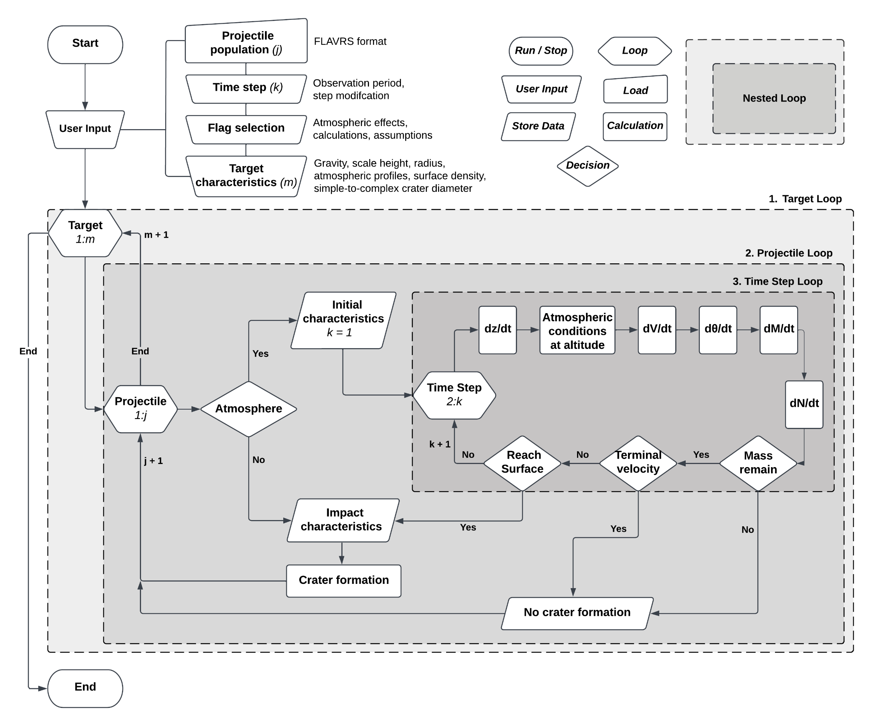
Atmospheric Effects Model: Pseudocode

Slide 4
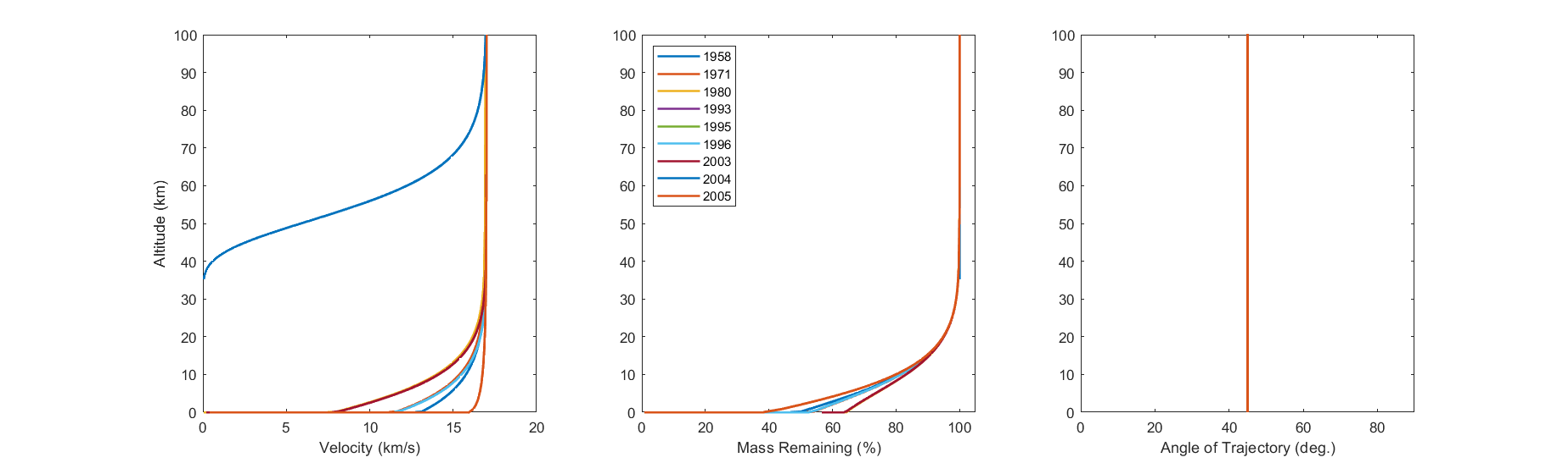
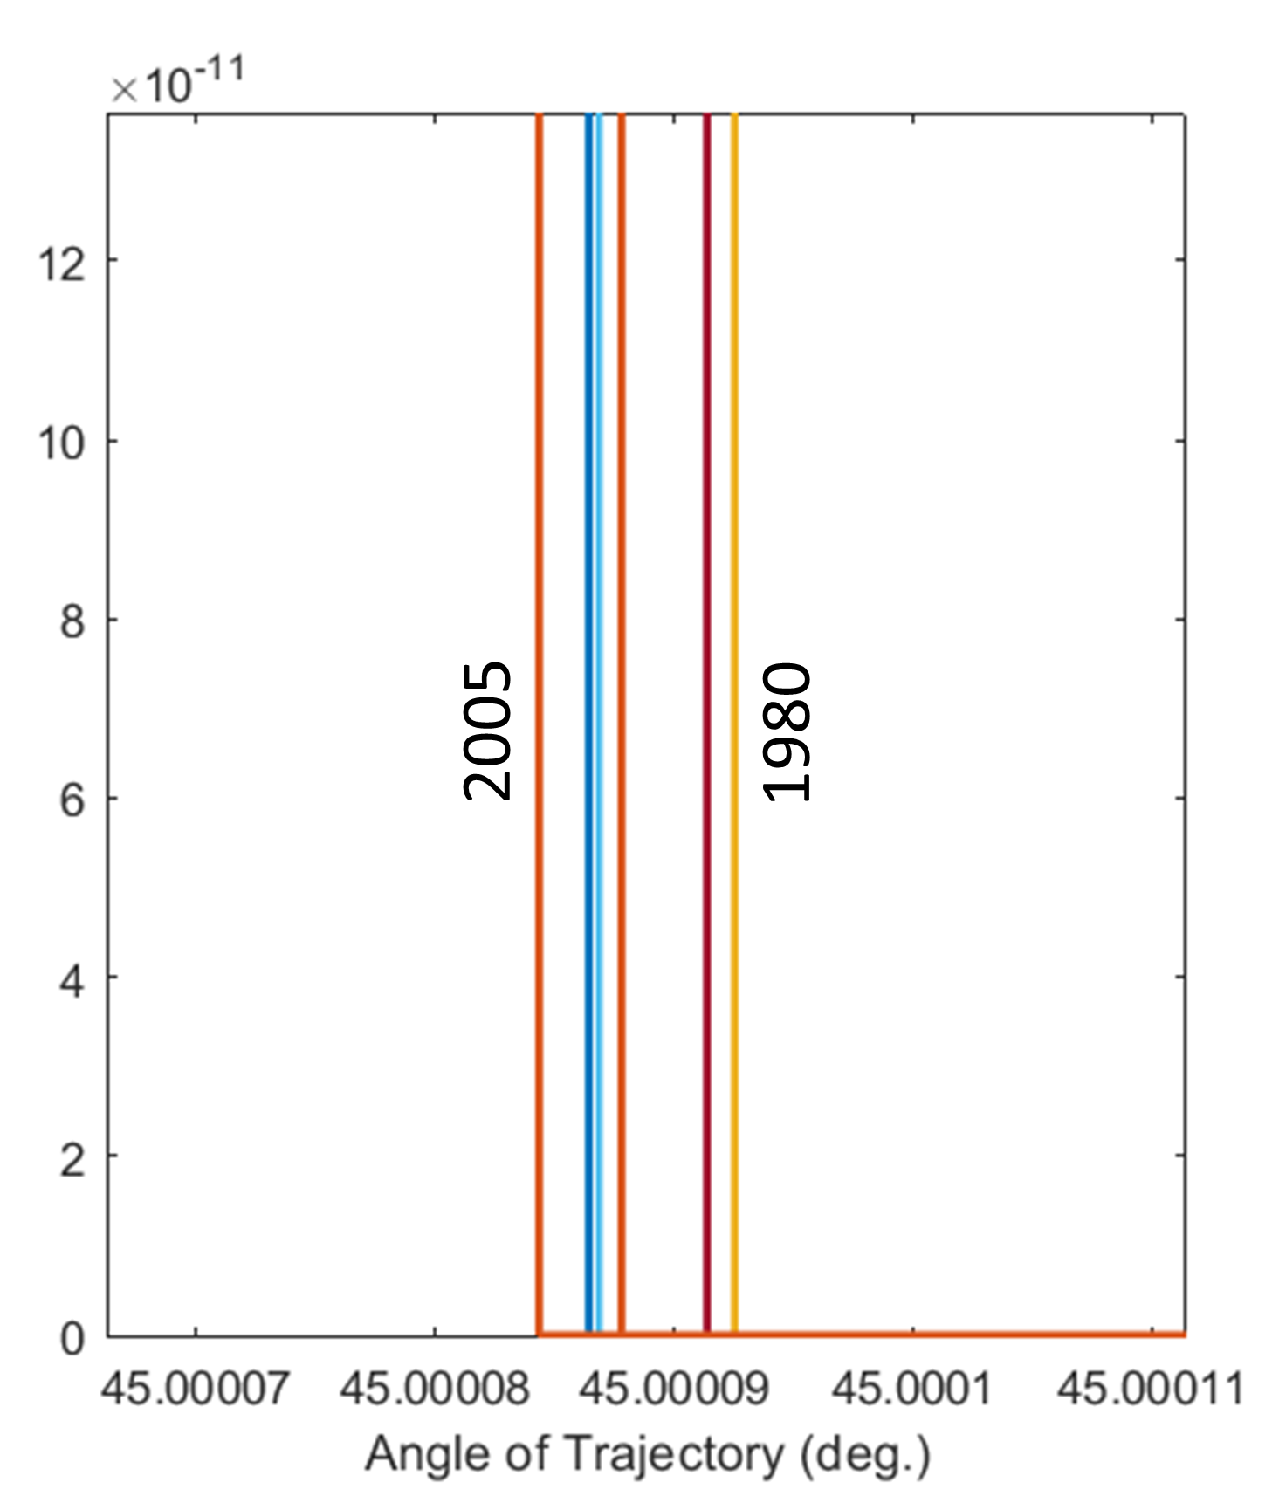
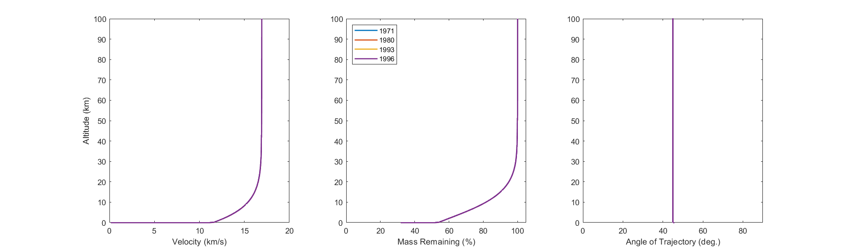
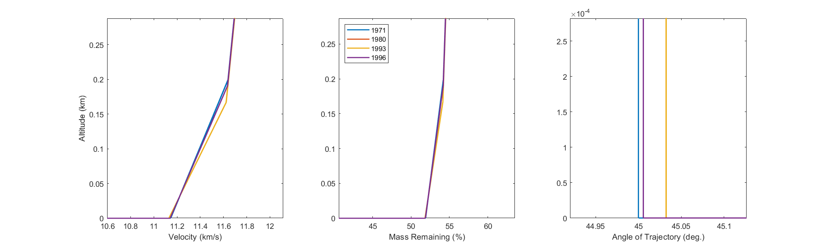
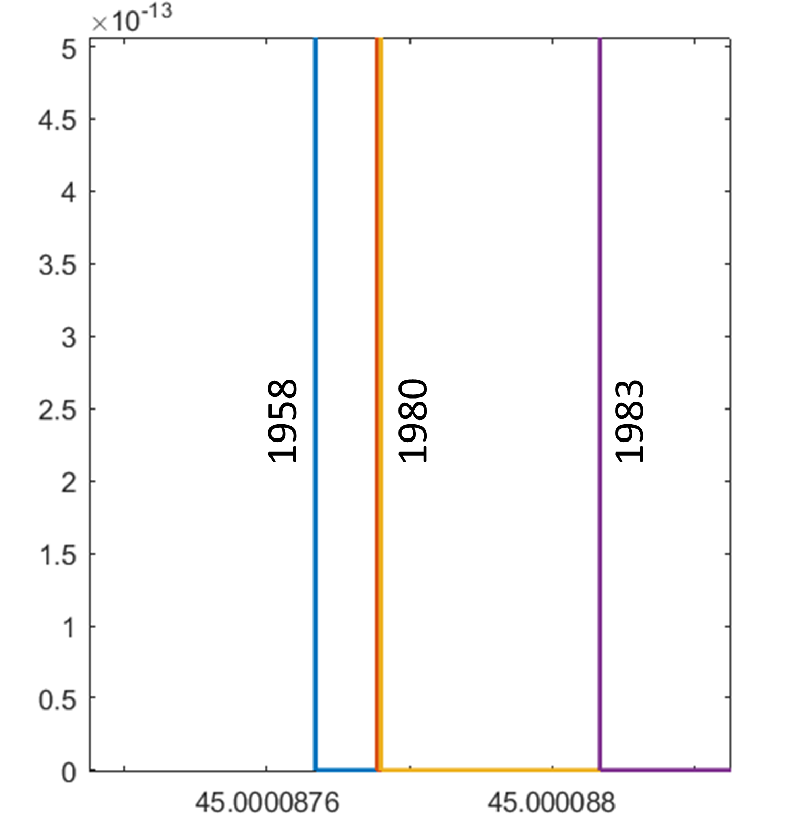
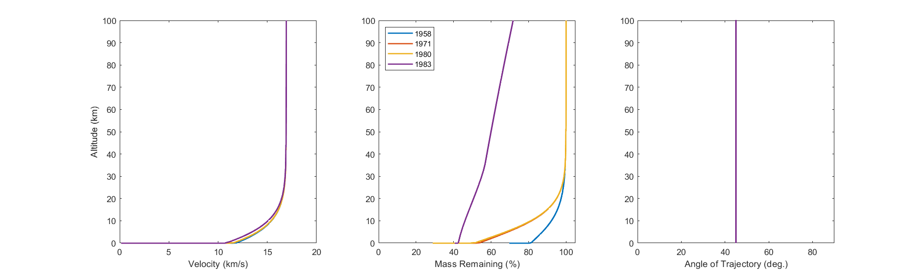
Model Sensitivity to Atmospheric Effect Equations
Change in Velocity
Change in Mass
Change in Angle
Hypothesized
Range
A. Change in Velocity
2004
2003
2005
2005
2003
B. Change in Angle
1971
1993
C. Change in Mass
1983
1983
1958
1980
1958
1971

Slide 5
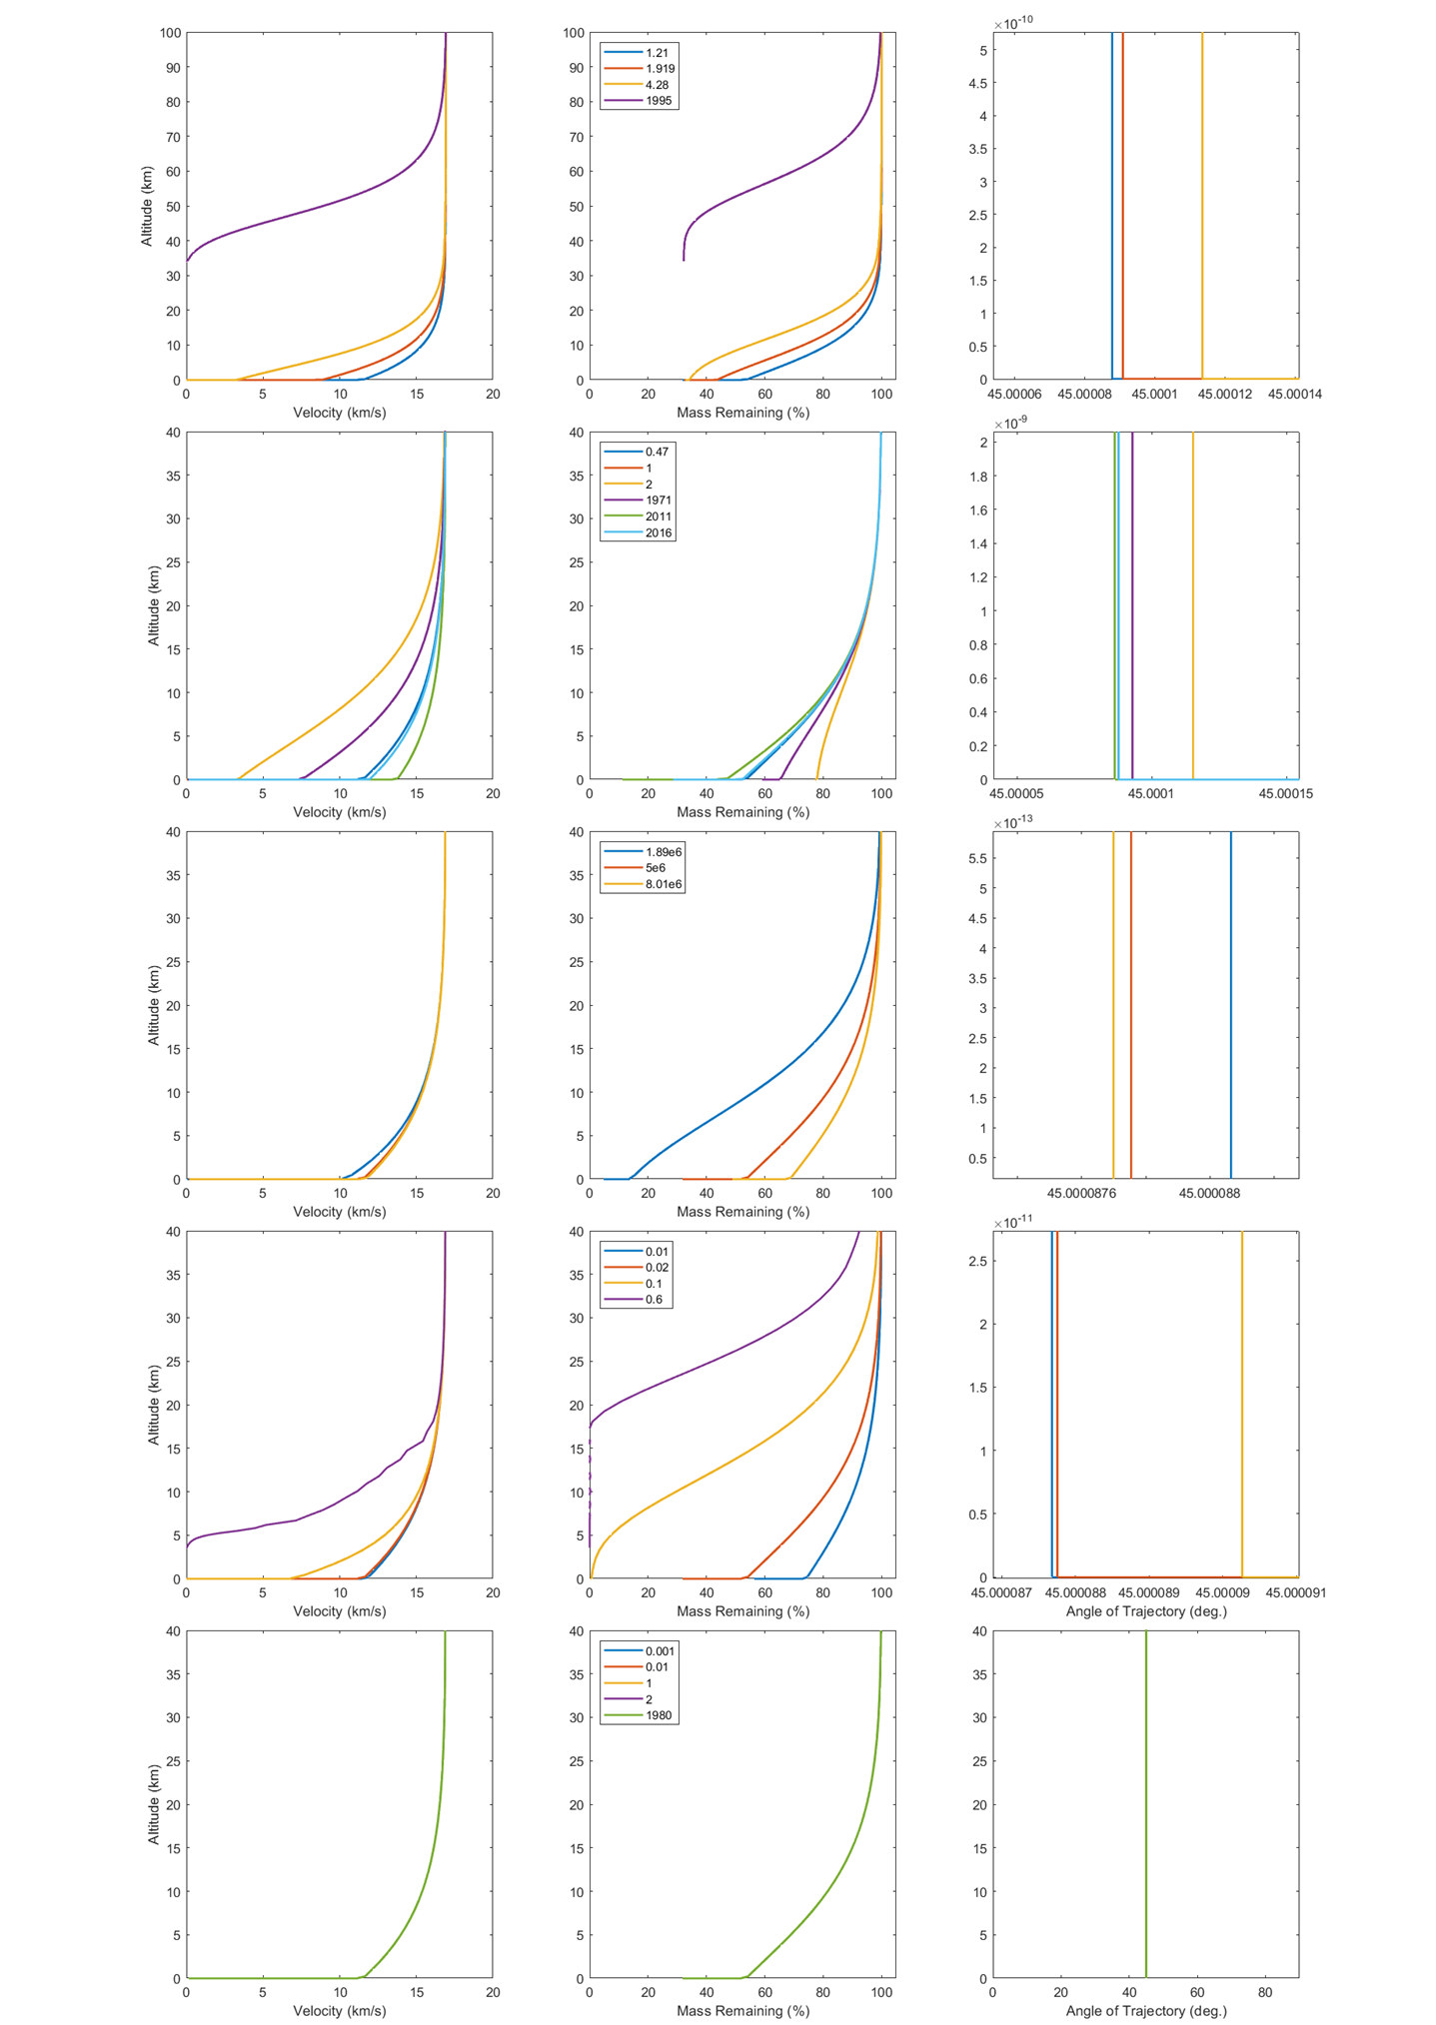
Model Sensitivity to Atmospheric Effect Parameters
Change in Velocity
Change in Mass
Change in Angle
Hypothesized
Range
1995
1995
1.21
4.28
A. Shape Factor
4.28
1.21
4.28
1.21
B. Drag Coefficient
2011
2
2
2
0.47
2011
2011
5e6
C. Heat of Ablation
8.01e6
1.98e6
1.98e6
5e6
1.98e6
8.01e6
8.01e6
0.6
0.01
0.1
D. Heat Transfer Coefficient
0.1
0.02
0.6
0.02
0.1
0.01
0.01
E. Lift Coefficient
1980
1980
0.001
1980
0.001
0.001

Slide 6
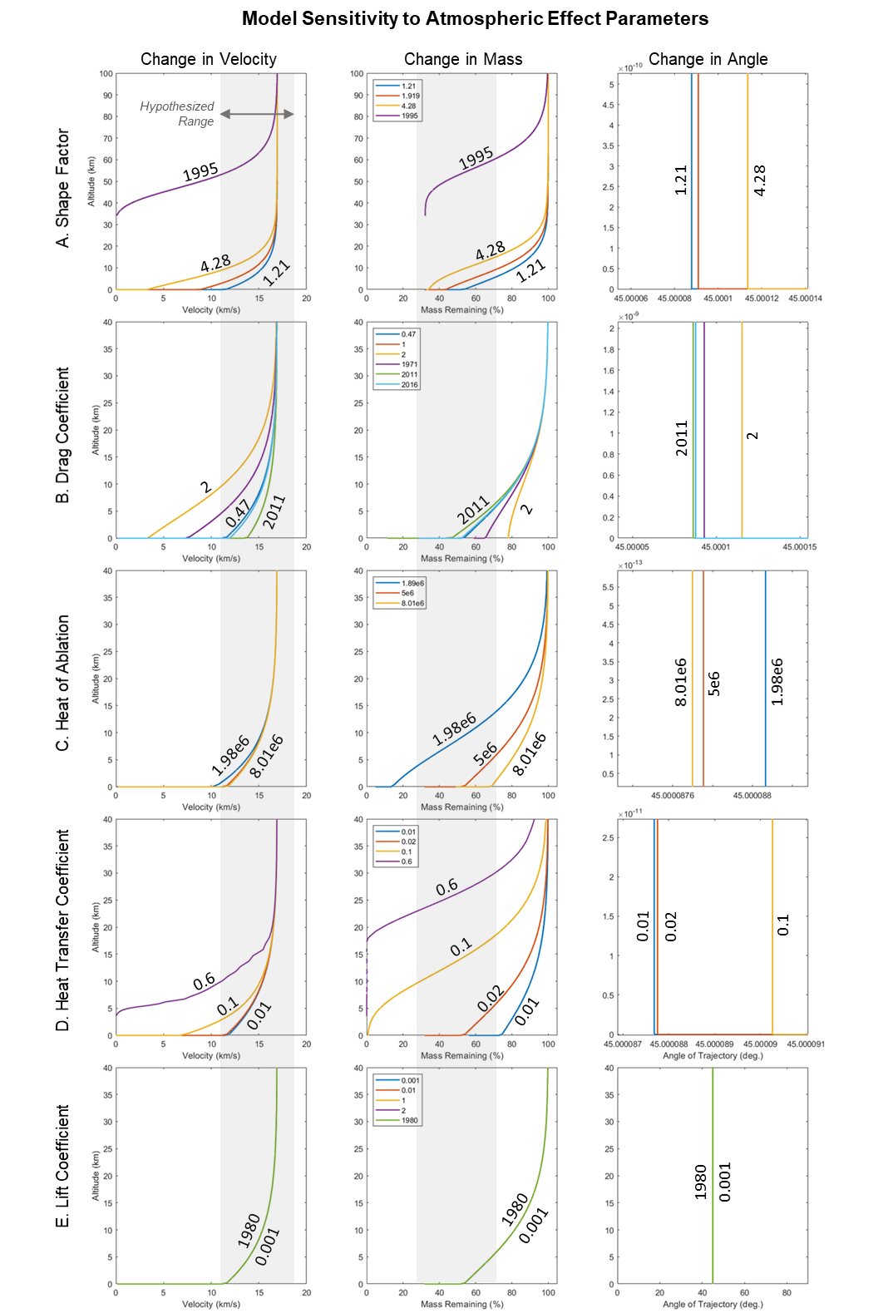

Slide 7
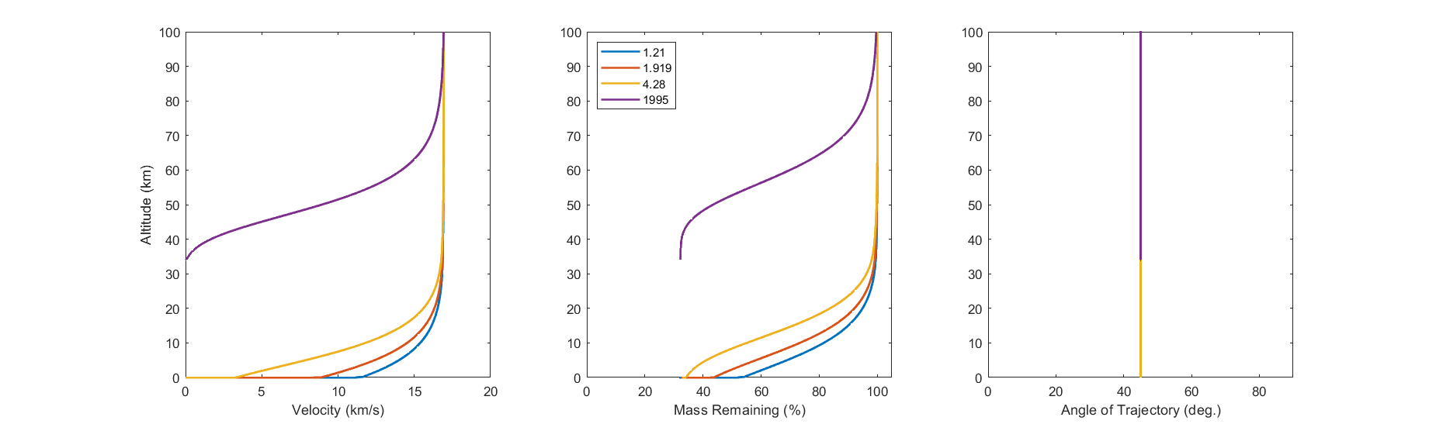
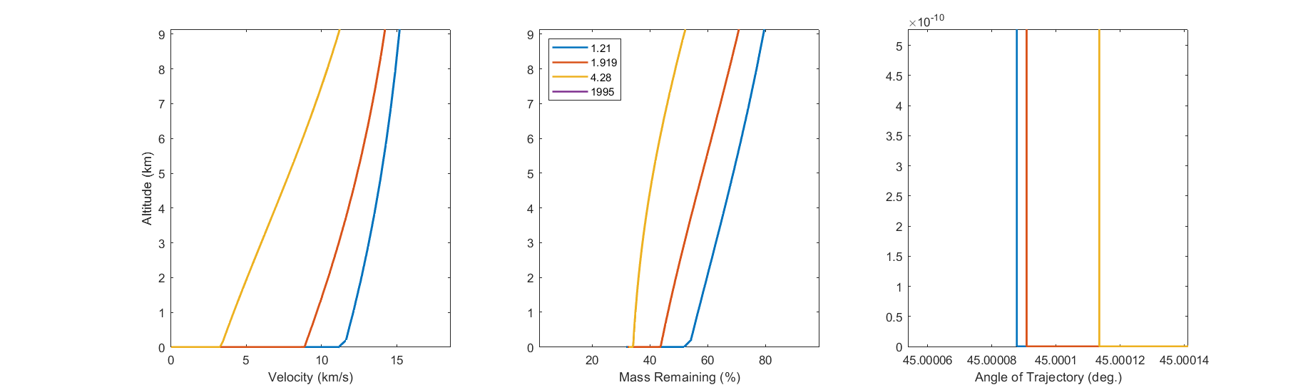
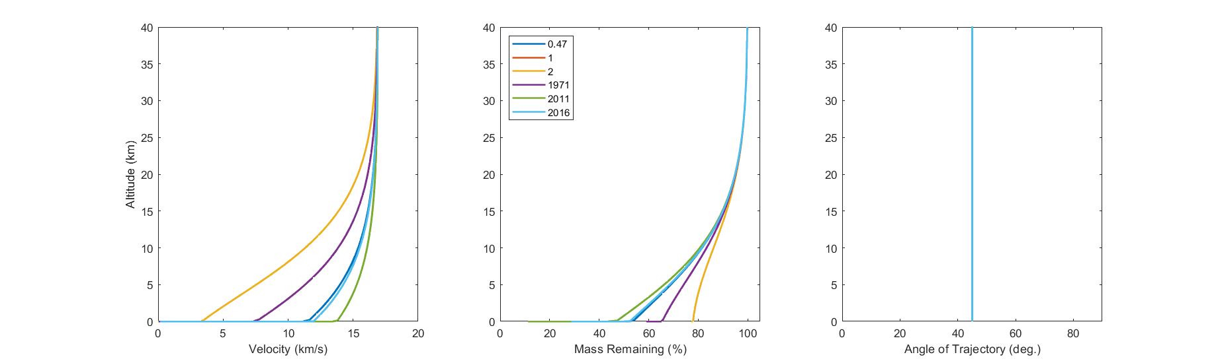
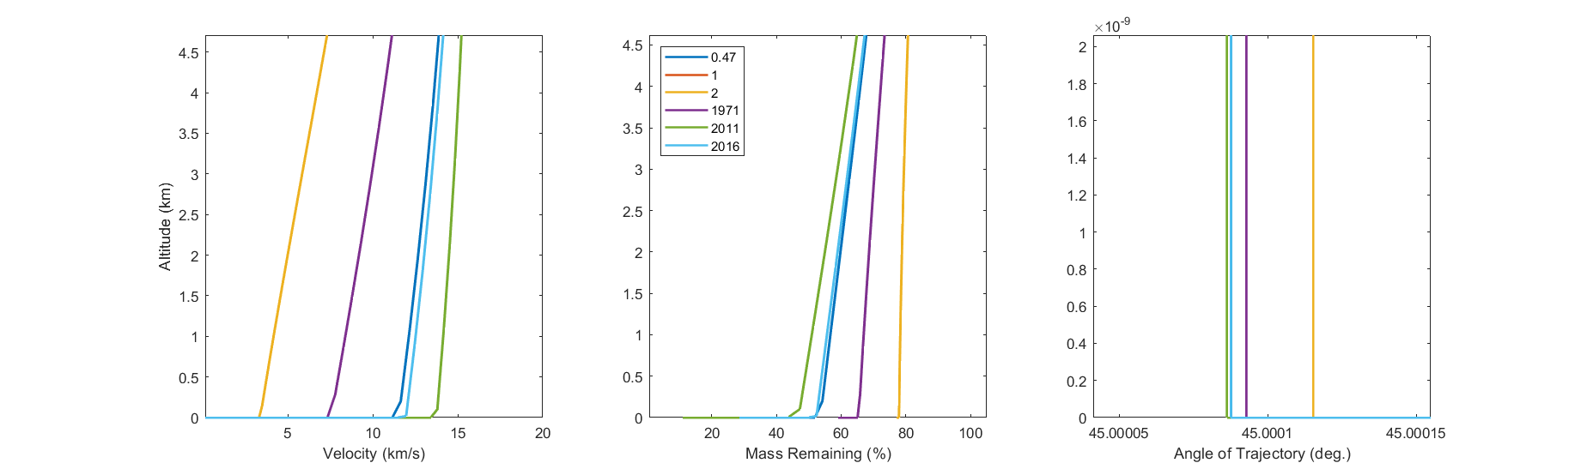
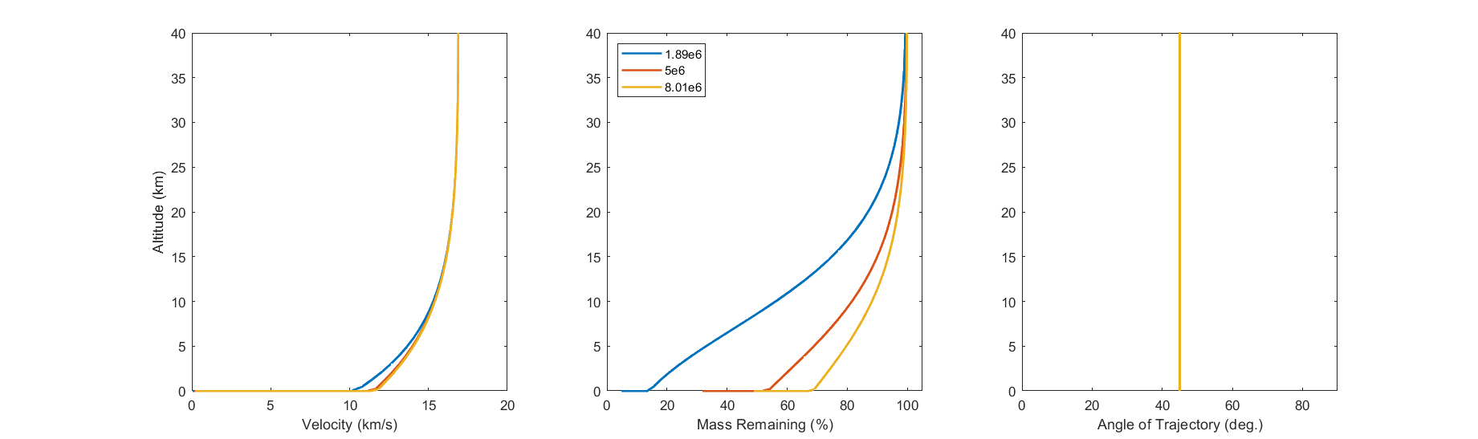
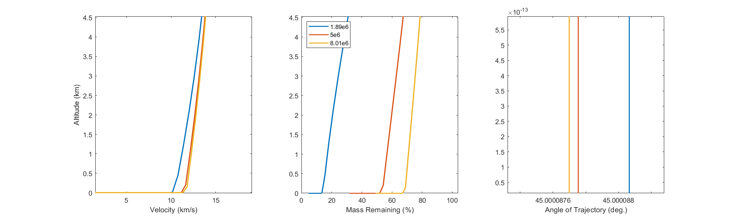
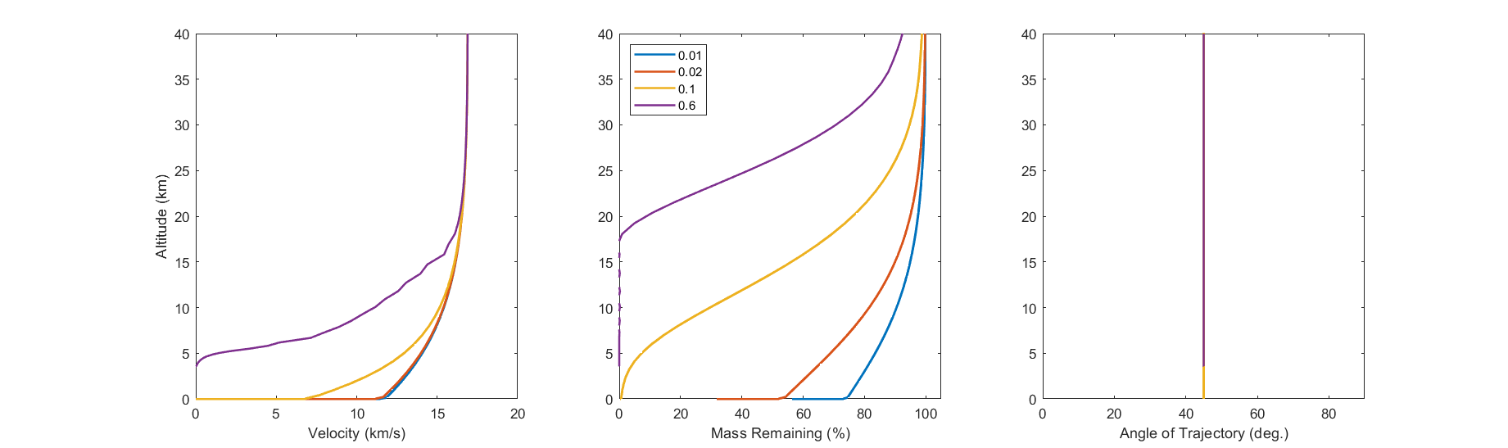
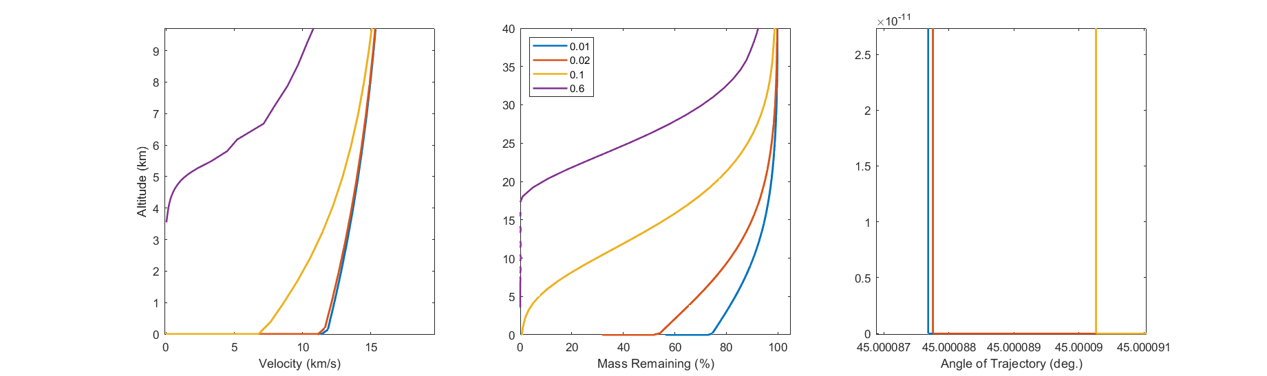
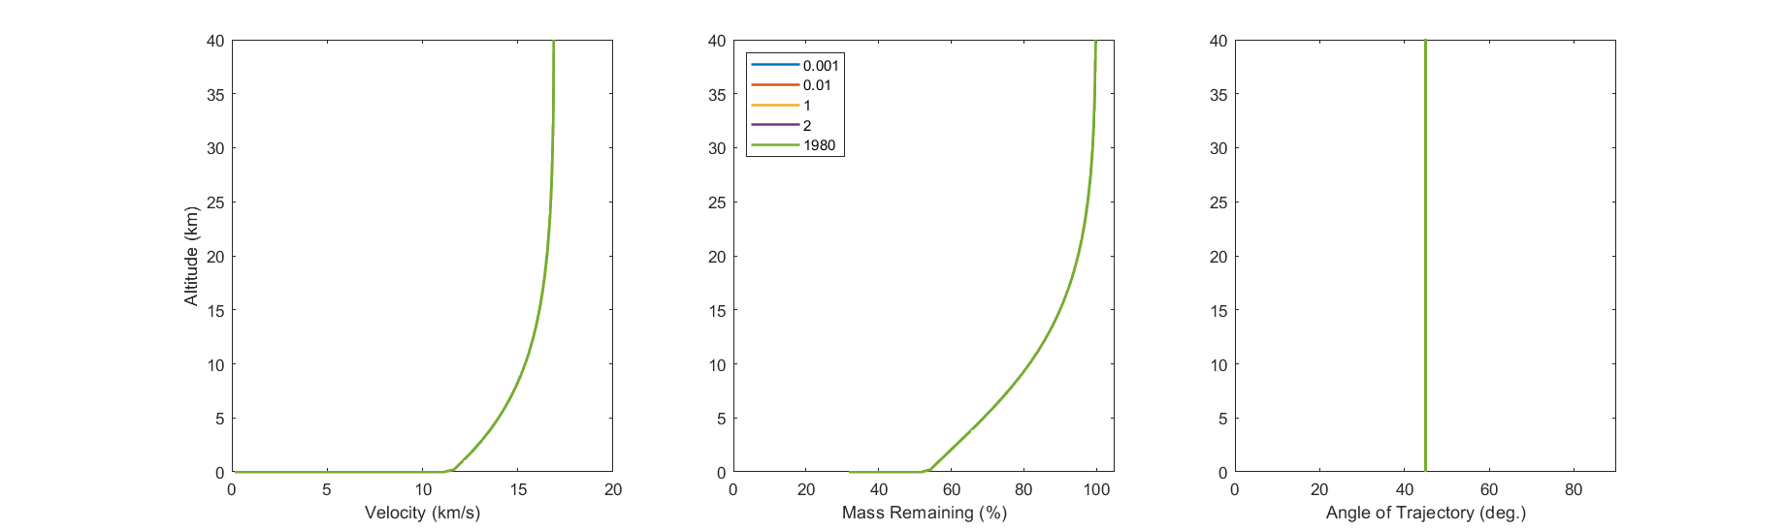

Slide 8
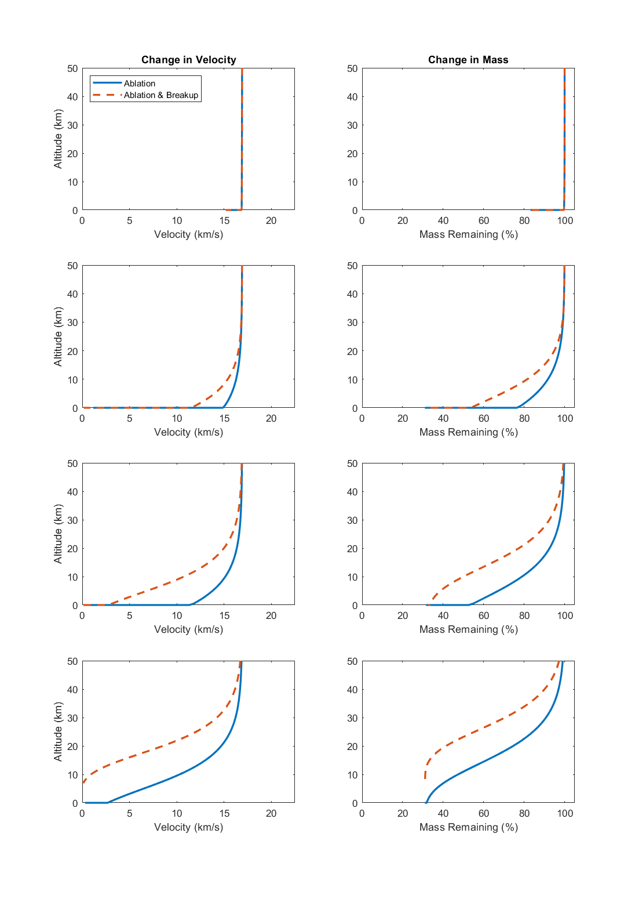
Velocity and Mass Evolutions of Terrestrial Analogs
Chicxulub Crater
AEM Impact
Characteristics
Theorized
Range
V_{f} = 16.8 km/s
M_{f} = 99.7 %
Θ_{f} = ~ 45 °
D_{f} = 13.9 km
Meteor Crater
V_{f} = 11 – 15 km/s
M_{f} = 51 – 77 %
Θ_{f} = ~ 45 °
D_{f} = 40 – 46 m
Chelyabinsk Bolide
V_{f} = 0 – 3 km/s
M_{f} = 0 – 32 %
Θ_{f} = ~ 20 °
D_{f} = 0 – 14 m
Observed Fragmentation
Tunguska Airburst
V_{f} = 2 – 12 km/s
M_{f} = 33 – 53 %
Θ_{f} = ~ 45 °
D_{f} = 34 – 41 m
Theorized
Airburst Altitude
Notes:
flag.vel(1) = 1971;
flag.shape(1) = 1.21;
flag.drag(1) = 0.47;
flag.ang(1) = 1971;
flag.lift(1) = 0.01;
flag.mass(1) = 1971;
flag.htc(1) = 0.02;
flag.hoa(1) = 5e6;
flag.zrho(1) = 1;
FLAVRS = load('ProjPop_TerrestrialAnalog_v4_FLAVRSM.mat'); % Terrestrial Analog Pop (correct densities)
FLAVRS = FLAVRS.FLAVRS;
% figure(11)
% k = 1;
% subplot(4,2,1)
% plot(Evel(k,:).'/1000,Ealt(k,:).'/1000,'-','LineWidth',2); hold on;
% xlim([0 22.5]); ylim([0 50]); xlabel('Velocity (km/s)'); ylabel('Altitude (km)');
% legend('Ablation','Ablation & Breakup','location','northwest')
% title('Change in Velocity');
% subplot(4,2,2)
% plot(Emassr(k,:).',Ealt(k,:).'/1000.','-','LineWidth',2); hold on;
% xlim([0 105]); ylim([0 50]); xlabel('Mass Remaining (%)');
% title('Change in Mass');
% k = 2;
% subplot(4,2,3)
% plot(Evel(k,:).'/1000,Ealt(k,:).'/1000,'-','LineWidth',2); hold on;
% xlim([0 22.5]); ylim([0 50]); xlabel('Velocity (km/s)'); ylabel('Altitude (km)');
% subplot(4,2,4)
% plot(Emassr(k,:).',Ealt(k,:).'/1000.','-','LineWidth',2); hold on;
% xlim([0 105]); ylim([0 50]); xlabel('Mass Remaining (%)');
% k = 3;
% subplot(4,2,5)
% plot(Evel(k,:).'/1000,Ealt(k,:).'/1000,'-','LineWidth',2); hold on;
% xlim([0 22.5]); ylim([0 50]); xlabel('Velocity (km/s)'); ylabel('Altitude (km)');
% subplot(4,2,6)
% plot(Emassr(k,:).',Ealt(k,:).'/1000.','-','LineWidth',2); hold on;
% xlim([0 105]); ylim([0 50]); xlabel('Mass Remaining (%)');
% k = 4;
% subplot(4,2,7)
% plot(Evel(k,:).'/1000,Ealt(k,:).'/1000,'-','LineWidth',2); hold on;
% xlim([0 22.5]); ylim([0 50]); xlabel('Velocity (km/s)'); ylabel('Altitude (km)');
% subplot(4,2,8)
% plot(Emassr(k,:).',Ealt(k,:).'/1000.','-','LineWidth',2); hold on;
% xlim([0 105]); ylim([0 50]); xlabel('Mass Remaining (%)');

Slide 9
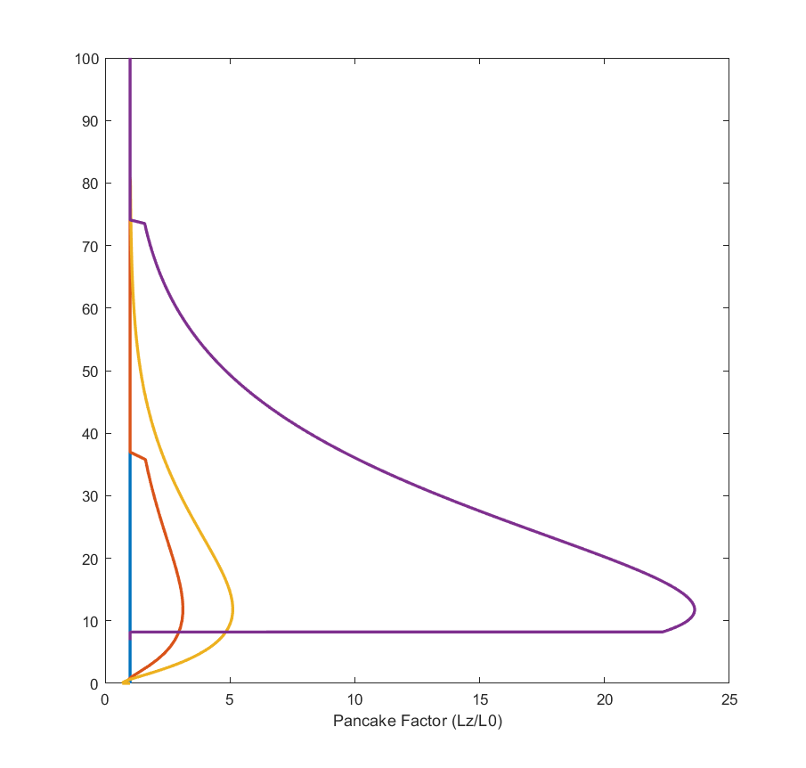
Dispersion of Terrestrial Analogs
Airburst Limit
Chicxulub
Chyba et al.
(1993)
Meteor
Chelyabinsk
This Study
Tunguska
Collins et al.
(2005)
Altitude (km)
Tunguska
Chelyabinsk
Meteor
Chicxulub
Pancake Factor (L_{Z}/L₀)
Notes:
flag.vel(1) = 1971;
flag.shape(1) = 1.21;
flag.drag(1) = 0.47;
flag.ang(1) = 1971;
flag.lift(1) = 0.01;
flag.mass(1) = 1971;
flag.htc(1) = 0.02;
flag.hoa(1) = 5e6;
flag.zrho(1) = 1;
FLAVRS = load('ProjPop_TerrestrialAnalog_v4_FLAVRSM.mat'); % Terrestrial Analog Pop (correct densities)
FLAVRS = FLAVRS.FLAVRS;
plot(Epanfact.',Ealt.'/1000,'LineWidth',2); hold on; xlabel('Pancake Factor (Lz/L0)'); xlim([0 25]); ylim([0 200]); ylim([0 100]);

Slide 10
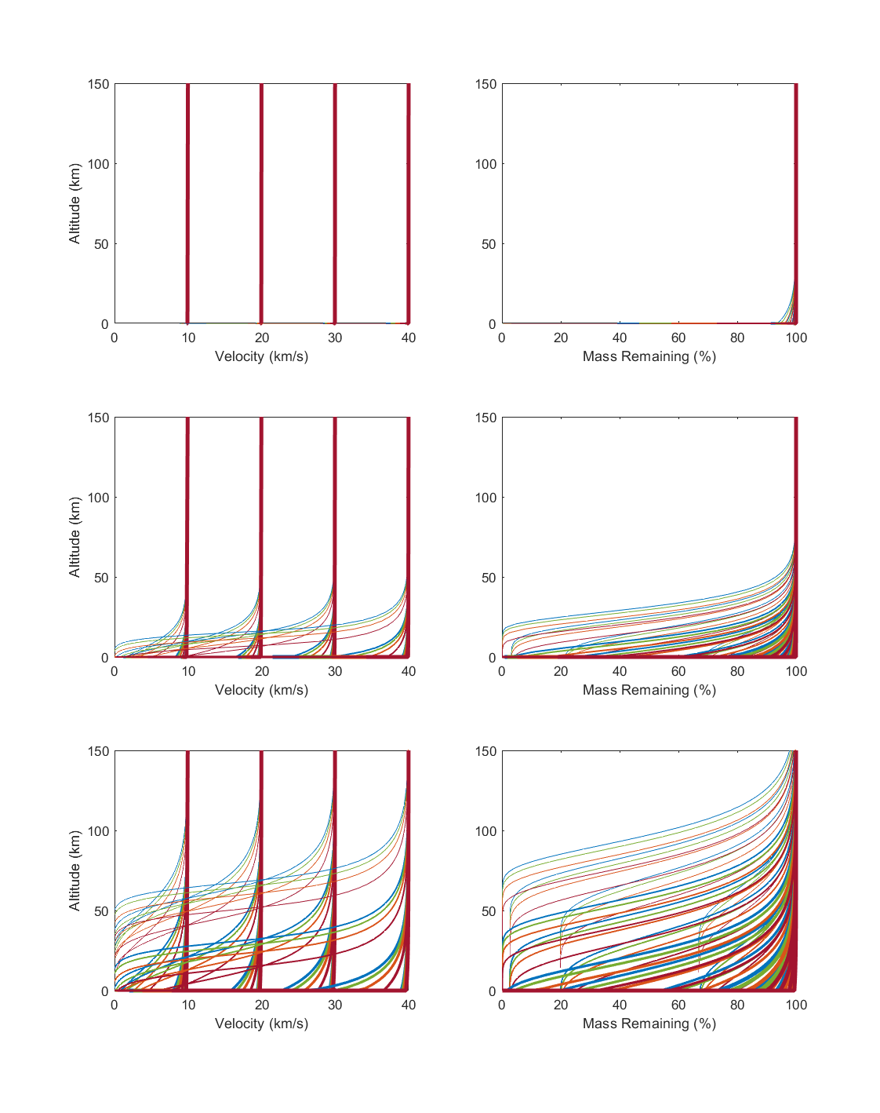

Theoretical Projectile Evolution with Ablation Only
Change in Velocity
Mars
Mass Remaining
Diameter
10 m
100 m
1 km
10 km
Density
Chondritic (2.7 g/cm³)
L_{i}
Stony (3.3 g/cm³)
10 m
10 m
Stony-Iron (4.5 g/cm³)
Iron (7.8 g/cm³)
Earth
V_{i}
30 km/s
20 km/s
10 km/s
L_{i}
10 m
100 m
Venus
V_{i}
30 km/s
20 km/s
10 km/s
L_{i}
10 m
100 m
1 km
10 km
Notes:
flag.vel(1) = 1971;
flag.shape(1) = 1.21;
flag.drag(1) = 0.47;
flag.ang(1) = 1971;
flag.lift(1) = 0.01;
flag.mass(1) = 1971;
flag.htc(1) = 0.02;
flag.hoa(1) = 5e6;
flag.zrho(1) = 1;
FLAVRS = load('ProjPop_10m-10km_allrho_10-40kms_45.mat'); % Array 2, ablation (population 1)
FLAVRS = FLAVRS.FLAVRS;
FLAVRS(:,3) = FLAVRS(:,11); % correct for FLAVRSM angle change up
figure(12)
for k = 1:n.projectiles
subplot(3,2,1);plot(Mvel(k,:)/1000,Malt(k,:)/1000,'Color',color_rhop(k,:),'LineWidth',width_Lp(k,:)); hold on; ylabel('Altitude (km)'); xlabel('Velocity (km/s)'); xlim([0 40]); ylim([0 150]);
subplot(3,2,2);plot(Mmassr(k,:),Malt(k,:)/1000,'Color',color_rhop(k,:),'LineWidth',width_Lp(k,:)); hold on; xlabel('Mass Remaining (%)'); xlim([0 100]); ylim([0 200]);
subplot(3,2,3);plot(Evel(k,:)/1000,Ealt(k,:)/1000,'Color',color_rhop(k,:),'LineWidth',width_Lp(k,:)); hold on; ylabel('Altitude (km)'); xlabel('Velocity (km/s)'); xlim([0 40]); ylim([0 150]);
subplot(3,2,4);plot(Emassr(k,:),Ealt(k,:)/1000,'Color',color_rhop(k,:),'LineWidth',width_Lp(k,:)); hold on; xlabel('Mass Remaining (%)'); xlim([0 100]); ylim([0 200]);
subplot(3,2,5);plot(Vvel(k,:)/1000,Valt(k,:)/1000,'Color',color_rhop(k,:),'LineWidth',width_Lp(k,:)); hold on; ylabel('Altitude (km)'); xlabel('Velocity (km/s)'); xlim([0 40]); ylim([0 150]);
subplot(3,2,6);plot(Vmassr(k,:),Valt(k,:)/1000,'Color',color_rhop(k,:),'LineWidth',width_Lp(k,:)); hold on; xlabel('Mass Remaining (%)'); xlim([0 100]); ylim([0 200]);
end

Slide 11
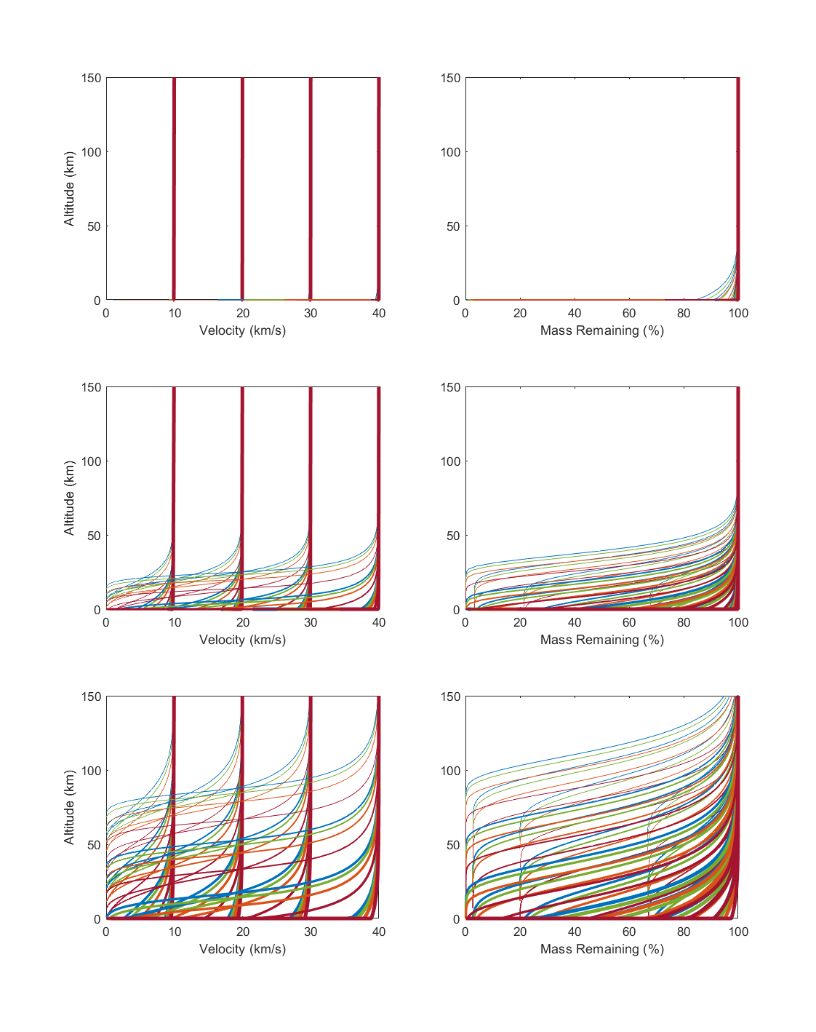
Theoretical Projectile Evolution with Ablation & Fragmentation
Change in Velocity
Mars
Mass Remaining
Diameter
10 m
100 m
1 km
10 km
Density
Chondritic (2.7 g/cm³)
L_{i}
Stony (3.3 g/cm³)
10 m
10 m
Stony-Iron (4.5 g/cm³)
Iron (7.8 g/cm³)
Earth
V_{i}
30 km/s
20 km/s
10 km/s
L_{i}
10 m
100 m
1 km
Venus
V_{i}
L_{i}
30 km/s
20 km/s
10 km/s
10 m
100 m
1 km
10 km
Notes:
flag.vel(1) = 1971;
flag.shape(1) = 1.21;
flag.drag(1) = 0.47;
flag.ang(1) = 1971;
flag.lift(1) = 0.01;
flag.mass(1) = 1971;
flag.htc(1) = 0.02;
flag.hoa(1) = 5e6;
flag.zrho(1) = 1;
FLAVRS = load('ProjPop_10m-10km_allrho_10-40kms_45.mat'); % Array 2, ablation (population 1)
FLAVRS = FLAVRS.FLAVRS;
FLAVRS(:,3) = FLAVRS(:,11); % correct for FLAVRSM angle change up
figure(12)
for k = 1:n.projectiles
subplot(3,2,1);plot(Mvel(k,:)/1000,Malt(k,:)/1000,'Color',color_rhop(k,:),'LineWidth',width_Lp(k,:)); hold on; ylabel('Altitude (km)'); xlabel('Velocity (km/s)'); xlim([0 40]); ylim([0 150]);
subplot(3,2,2);plot(Mmassr(k,:),Malt(k,:)/1000,'Color',color_rhop(k,:),'LineWidth',width_Lp(k,:)); hold on; xlabel('Mass Remaining (%)'); xlim([0 100]); ylim([0 200]);
subplot(3,2,3);plot(Evel(k,:)/1000,Ealt(k,:)/1000,'Color',color_rhop(k,:),'LineWidth',width_Lp(k,:)); hold on; ylabel('Altitude (km)'); xlabel('Velocity (km/s)'); xlim([0 40]); ylim([0 150]);
subplot(3,2,4);plot(Emassr(k,:),Ealt(k,:)/1000,'Color',color_rhop(k,:),'LineWidth',width_Lp(k,:)); hold on; xlabel('Mass Remaining (%)'); xlim([0 100]); ylim([0 200]);
subplot(3,2,5);plot(Vvel(k,:)/1000,Valt(k,:)/1000,'Color',color_rhop(k,:),'LineWidth',width_Lp(k,:)); hold on; ylabel('Altitude (km)'); xlabel('Velocity (km/s)'); xlim([0 40]); ylim([0 150]);
subplot(3,2,6);plot(Vmassr(k,:),Valt(k,:)/1000,'Color',color_rhop(k,:),'LineWidth',width_Lp(k,:)); hold on; xlabel('Mass Remaining (%)'); xlim([0 100]); ylim([0 200]);
end

Slide 12
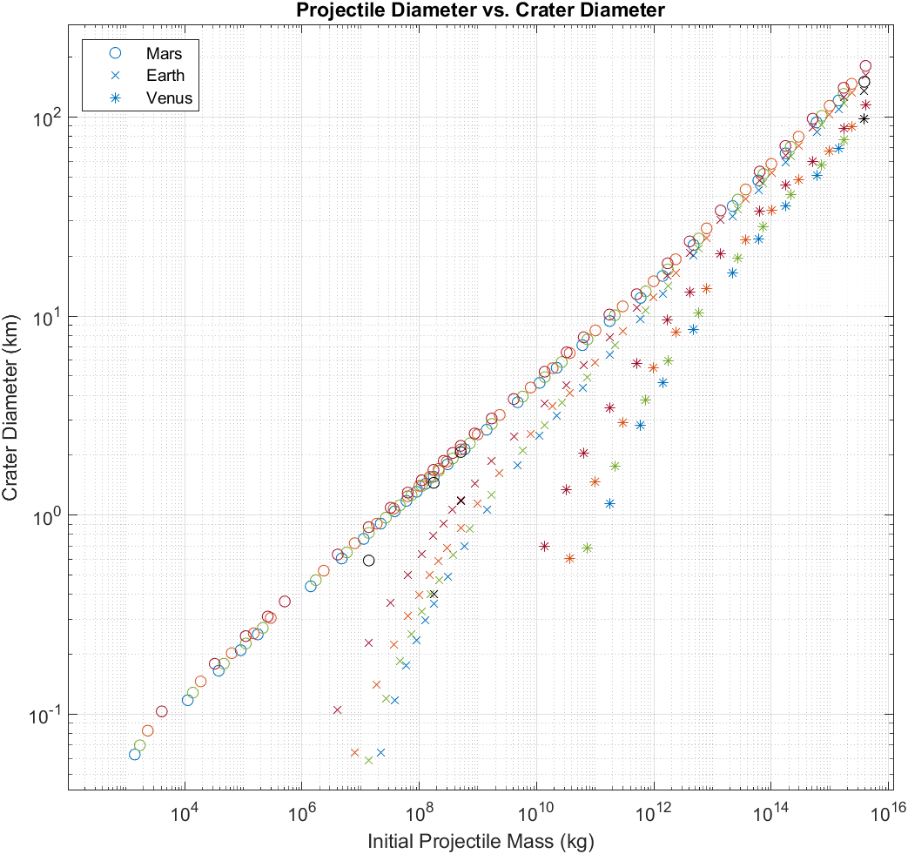
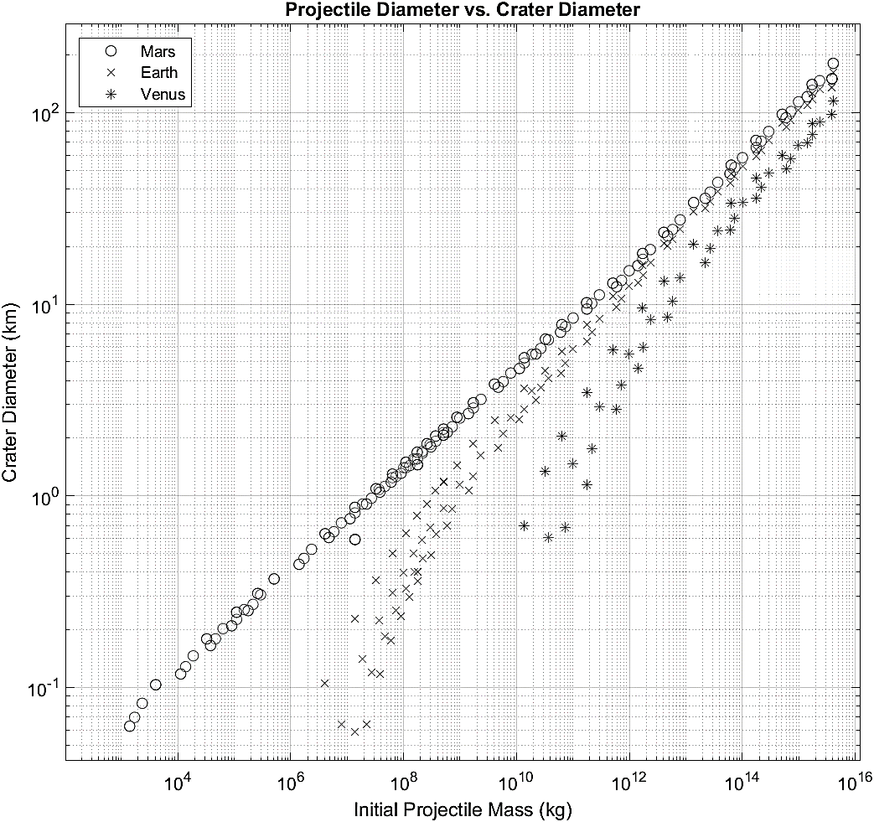
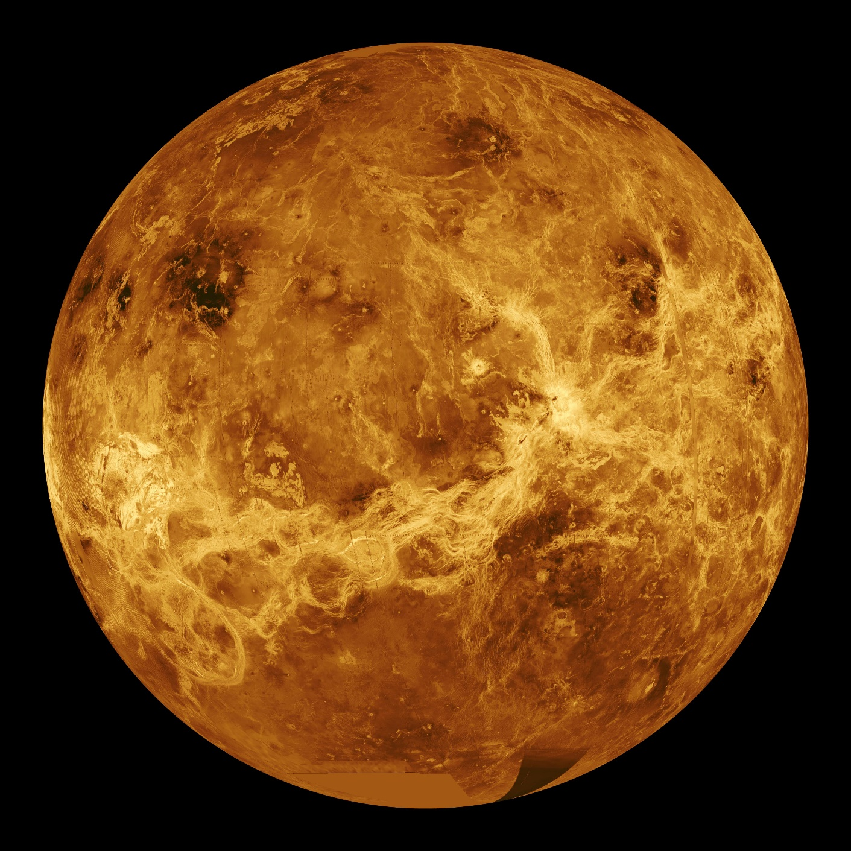
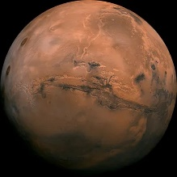
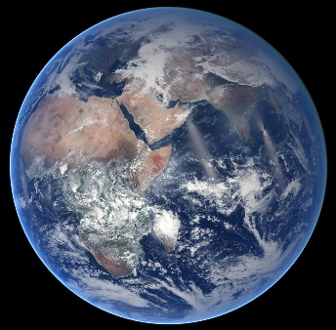
Initial Projectile Mass vs. Final Crater Diameter
Planetary Target
Mars
100
Earth
Venus
Density
Chondritic (2.7 g/cm³)
Stony (3.3 g/cm³)
Stony-Iron (4.5 g/cm³)
Chelyabinsk Meteor
Tunguska Air Burst
Iron (7.8 g/cm³)
Meteor Crater
Chicxulub Crater
Theoretical Projectiles
Vi = 20 km/s
Θ_{i} = 45 °
D_{i} = 1 m – 100 km
10
Final Crater Diameter (km)
1
0.100
10³
10⁴
10⁶
10⁸
10¹⁰
10¹²
10¹⁴
10¹⁶
Initial Projectile Mass (kg)

Slide 13
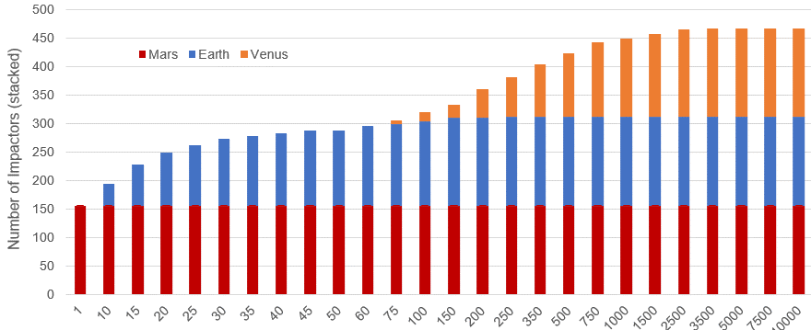
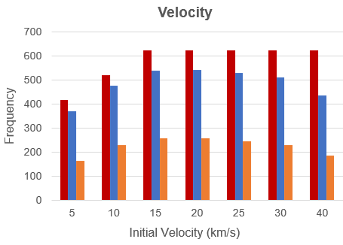
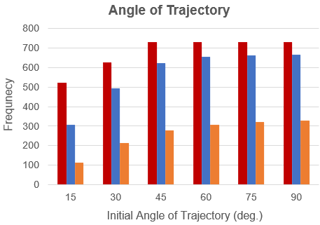
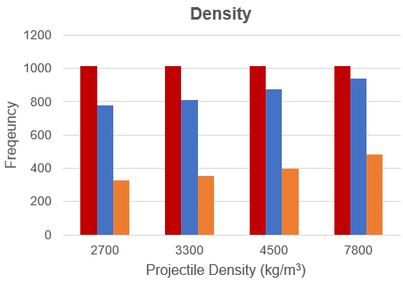
Initial Characteristics of Theoretical Impactors
A. Diameter
Mars
Earth
Venus
Venus
Number of Impactors (Stacked)
Earth
Mars
Mars
Initial Diameter (m)
B. Velocity
C. Angle of Trajectory
D. Density
Mars
Frequency
Earth
Frequency
Frequency
Venus
Initial Velocity (km/s)
Initial Angle (deg.)
Projectile Density (kg/m³)
Notes:
* Made in Excel

Slide 14




Projectile Characteristic vs. Final Crater Diameter
Pancake Limit = 5
Pancake Gap
D_{mod} = 100 m
Final Crater Diameter (km)
D_{mod} = 1 km
D_{mod} = 10 km
Initial Angle
(deg.)
Initial Mass
(kg)
Initial Velocity
(km/s)
Pancake Factor
(at impact)
Notes:
* Made in R

